Slide 1

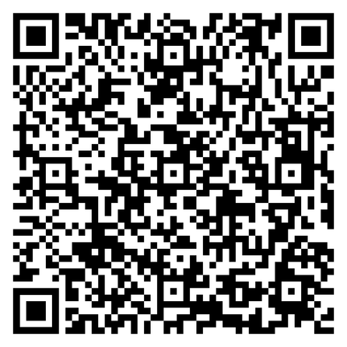
Feel free to ask us anything or just have a chat before we start! We have not started recording yet and would love to hear from you how you are feeling!
If you haven’t done so, please fill in this consent form so we can ensure ethical use of the data collected in this workshop

Slide 2





DECUS
Decolonizing Curriculums in Secondary Schools
Training Series
Funded by the European Union. Views and opinions expressed are however those of the author(s) only and do not necessarily reflect those of the European Union or the European Education and Culture Executive Agency (EACEA). Neither the European Union nor EACEA can be held responsible for them.

Slide 3

Heartfelt Reminder
YOUR WELL-BEING MATTERS. THIS MODULE IS INTENDED AS A SUPPORTIVE AND EDUCATIONAL SPACE. IF AT ANY POINT YOU FEEL UNCOMFORTABLE WITH A QUESTION OR ACTIVITY, PLEASE KNOW THAT YOU ARE FREE TO SKIP IT. PARTICIPATION IS ALWAYS VOLUNTARY. YOU ARE ENCOURAGED TO ENGAGE ONLY AT THE LEVEL YOU FEEL SAFE AND COMFORTABLE. ABOVE ALL, WE CARE ABOUT YOUR COMFORT, WELL-BEING, AND CONFIDENTIALITY. PLEASE ALSO REMEMBER TO TAKE A BREAK WHENEVER YOU NEED IT, BREATHE, STRETCH, AND STAY HYDRATED.

Slide 4

Recording & Consent
PLEASE NOTE THAT THIS SESSION WILL BE RECORDED (AUDIO, VIDEO, AND SCREEN SHARE) FOR RESEARCH, ACCESSIBILITY (E.G., TRANSCRIPTS), AND QUALITY IMPROVEMENT. RECORDINGS WILL ONLY BE ACCESSIBLE TO THE ORGANISING TEAM AND WILL NOT BE SHARED PUBLICLY WITHOUT YOUR EXPLICIT PERMISSION. YOU ARE, OF COURSE, FREE TO KEEP YOUR CAMERA OFF AND USE YOUR FIRST NAME ONLY IF YOU PREFER. THANK YOU FOR SUPPORTING AN INCLUSIVE AND RESPECTFUL LEARNING SPACE.
TO HELP US MEET ETHICAL RESEARCH STANDARDS, WE KINDLY ASK YOU TO COMPLETE THE CONSENT FORM PROVIDED.

Slide 5

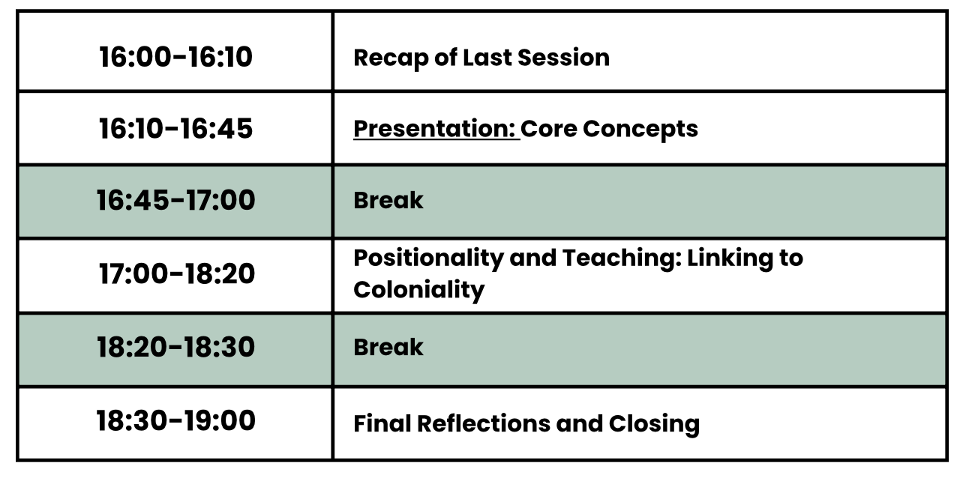

Module 2 Overview:
Agenda
16:00-16:10
Recap of Last Session
16:10-16:45
Presentation: Core Concepts
16:45-17:00
Break
17:00-18:20
Positionality and Teaching: Linking to Coloniality
18:20-18:30
Break
18:30-19:00
Final Reflections and Closing
Materials and slides can be found on pre-training materials platform afterwards

Slide 6

Module 2 Overview:
Collective Reflexivity
Anchors for the Module
Develop collective reflexivity by understanding how your identity and social location inform your teaching practices.
Recognize your own colonial biases and understand why diverse, collective reflection is essential for decolonizing practices.
Explore how white fragility, racism, and discrimination have been normalized over time and how they shape our relationships.

Slide 7


Let’s recap together!

Slide 8

What you left us in the mail

Slide 9





It raised my awareness of how coloniality is embedded in systems
I no longer carry guilt but responsibility — I’m committed to questioning what I consume and passing on change, not patterns.
Ignorance can feel easier than facing the 5 axes of decolonization.

Slide 10


Looking at
the Core Concepts

Slide 11
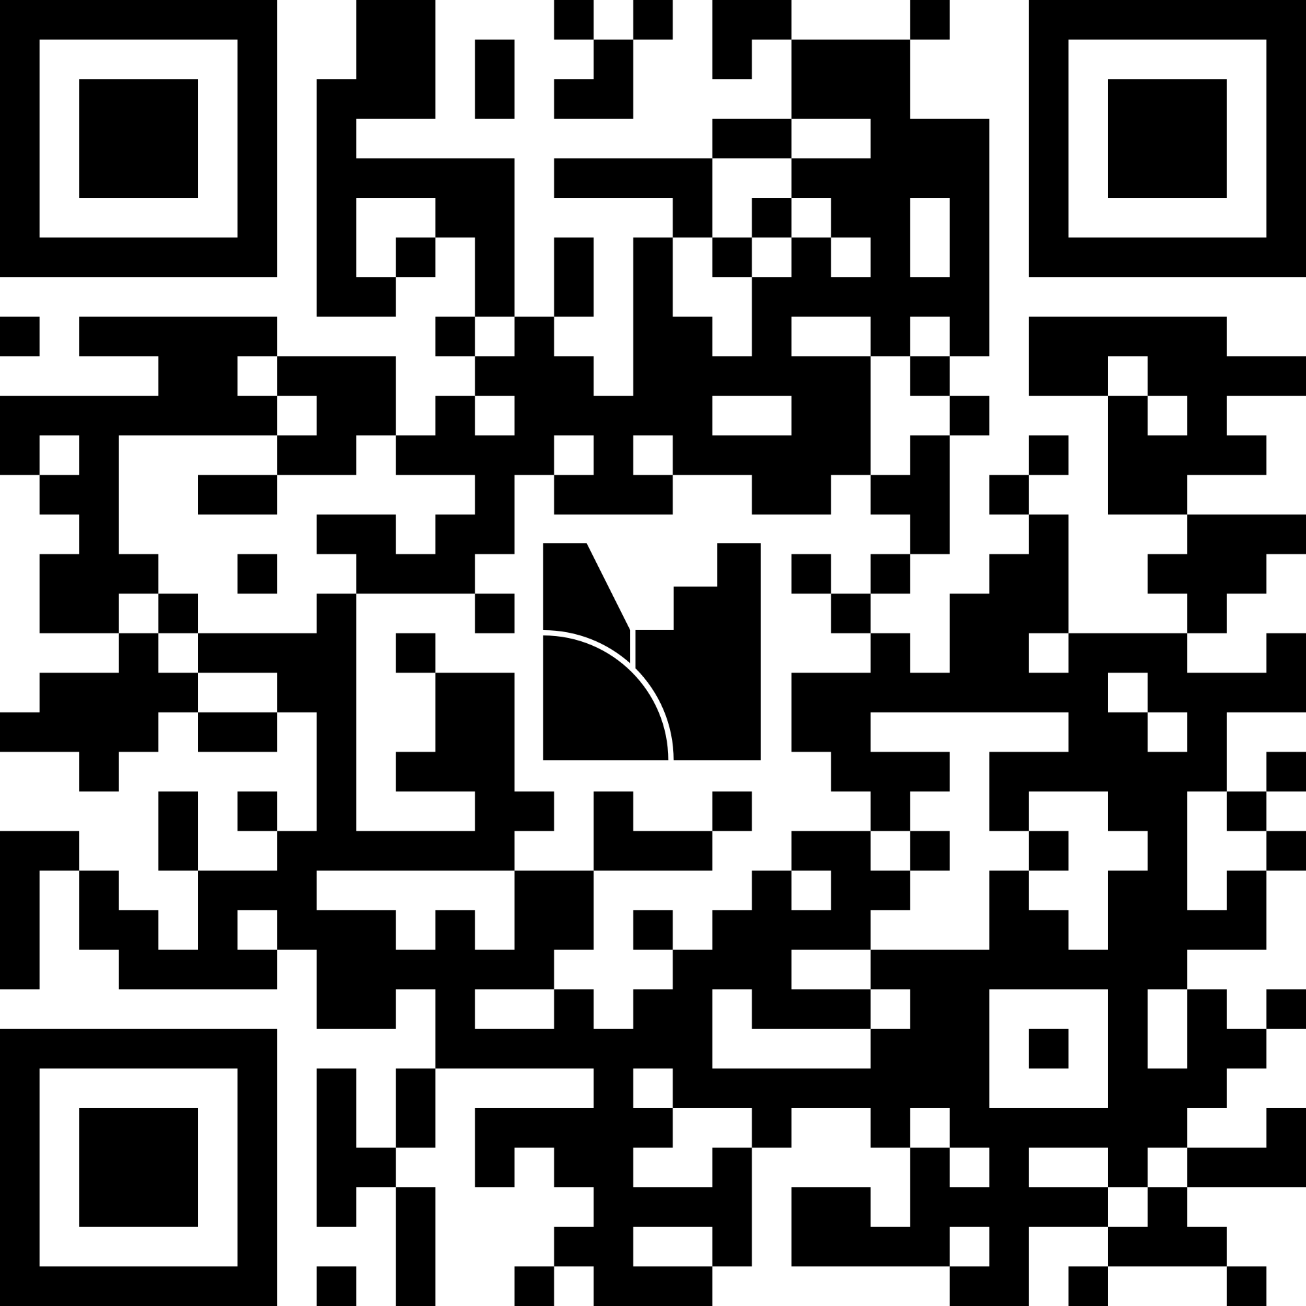

What does positionality mean to you?
20 mins

Slide 12

How your identity relates to your teaching practice
It is your personal sense of who you are, a collection of unique characteristics, beliefs, interests and life experiences that help us to define ourselves.
A person’s identity also includes chosen aspects like being a parent, a teacher, or a musician.
But also include our beliefs and affiliations

Slide 13

Social location describes your relationship to power and privilege in your society
Social location is a way to understand how multiple social identities (gender, class, race, etc.) intersect and contribute to your experience in society
LilNate
2

Slide 14

Why is positionality important
Positionality is the reflective process of understanding how our social location and its inherent power dynamics influence our understanding and engagement with the world.
It is a process of self-awareness and the recognition of our values, views, privileges and oppression in relation to others

Slide 15
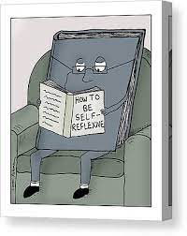
Self-Reflexivity as a tool to become more aware of our positionality
Self-reflexivity is the continual practice of critically analysing one’s thoughts, feelings, assumptions, values, and biases, especially in relation to their experiences and interactions with others.
© Loren Fishman
3

Slide 16
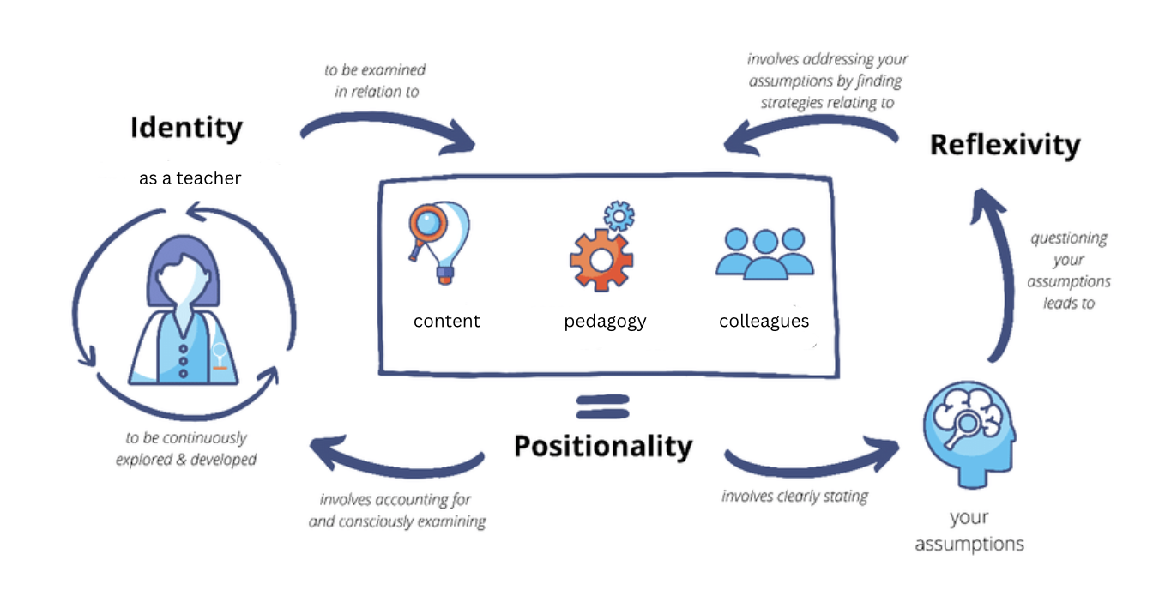
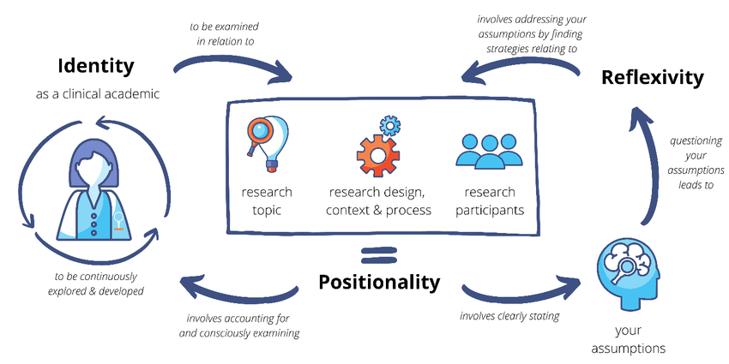
Self-Reflexivity as a tool to become more aware of our positionality
Reflexivity is meant to be self-accountability, an awareness of limitations, and an act of humility, recognising one’s inability to be objective.
It entails rethinking knowledge and the possibility that our thinking is clustered with stereotypes and held assumptions
as a teacher
content
pedagogy
colleagues
4

Slide 17


From confessional tales to acknowledging responsibility through collective reflexivity
Creating a space of empathetic listening that offers an opportunity to speak up about uncomfortable stories without fear of judgment.
Collective reflexivity provides an opportunity to challenge entrenched academic practices, norms, and values, as well as our own complicities and complexities.
Recognise the complexity and intricacy of power dynamics by using others’ stories as mirrors
4

Slide 18
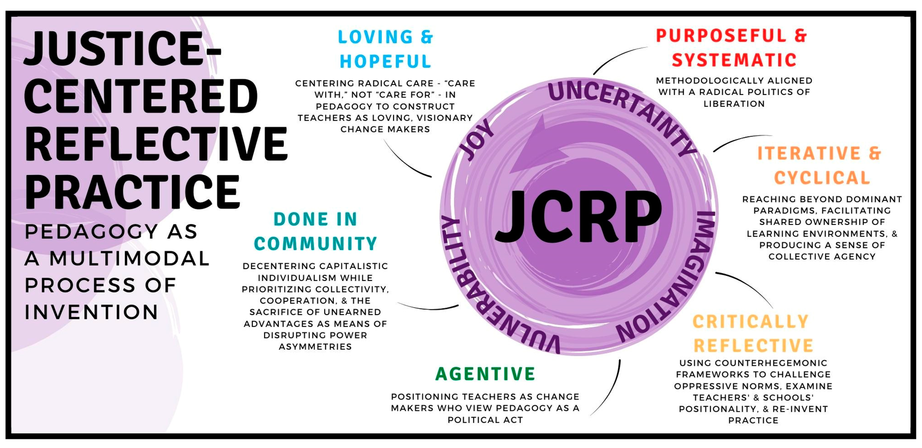
JCRP: A tool for shifting from individual self-awareness to collective reflexivity

Slide 19
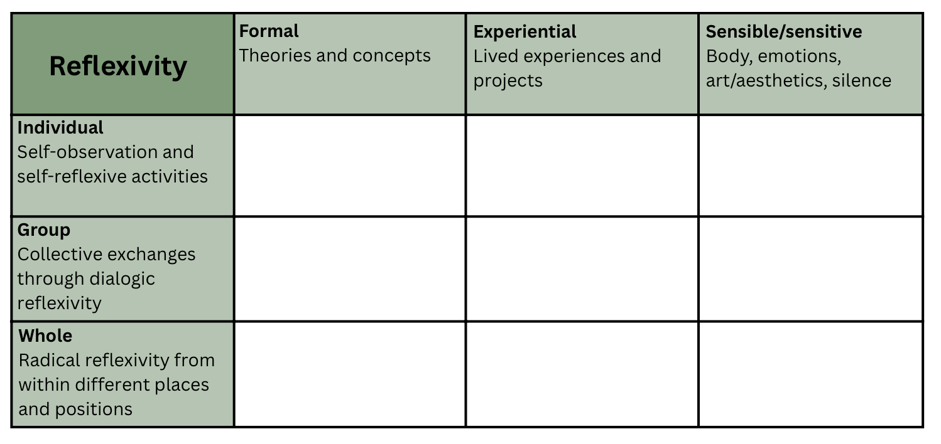
Radical Reflexivity: a tool for shifting from individual self-awareness to collective reflexivity
Formal
Theories and concepts
Experiential
Lived experiences and projects
Sensible/sensitive
Body, emotions, art/aesthetics, silence
Reflexivity
Individual
Self-observation and self-reflexive activities
Group
Collective exchanges through dialogic reflexivity
Whole
Radical reflexivity from within different places and positions

Slide 20


Take a moment to relax and re-center, we will see you here again in 10 minutes!

Slide 21
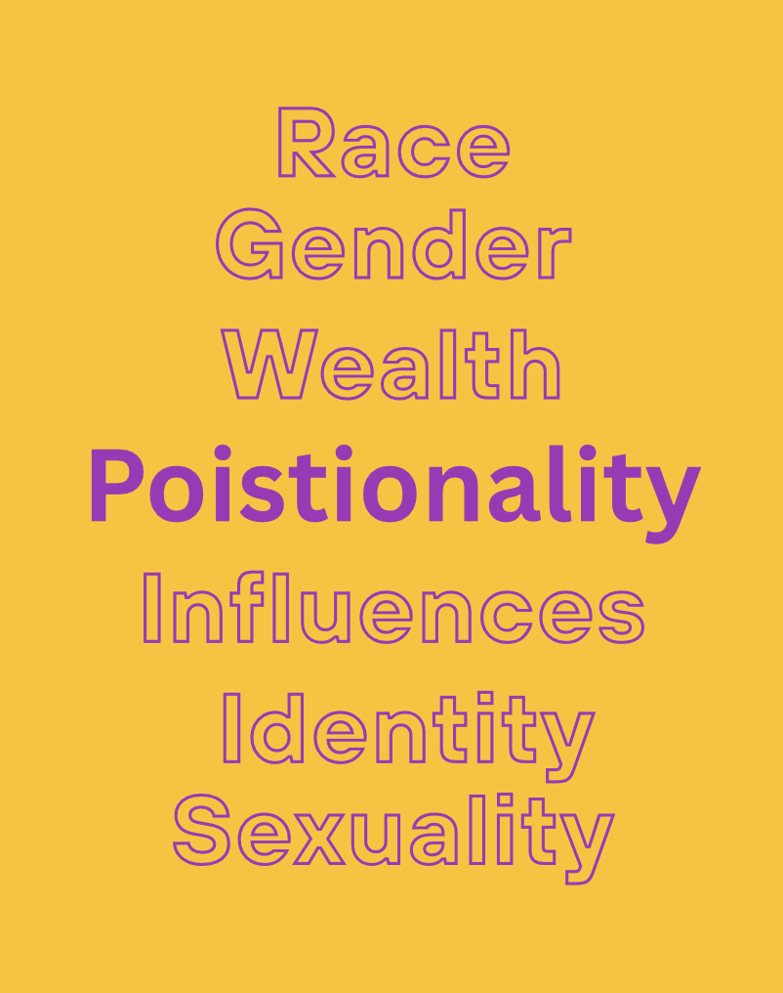
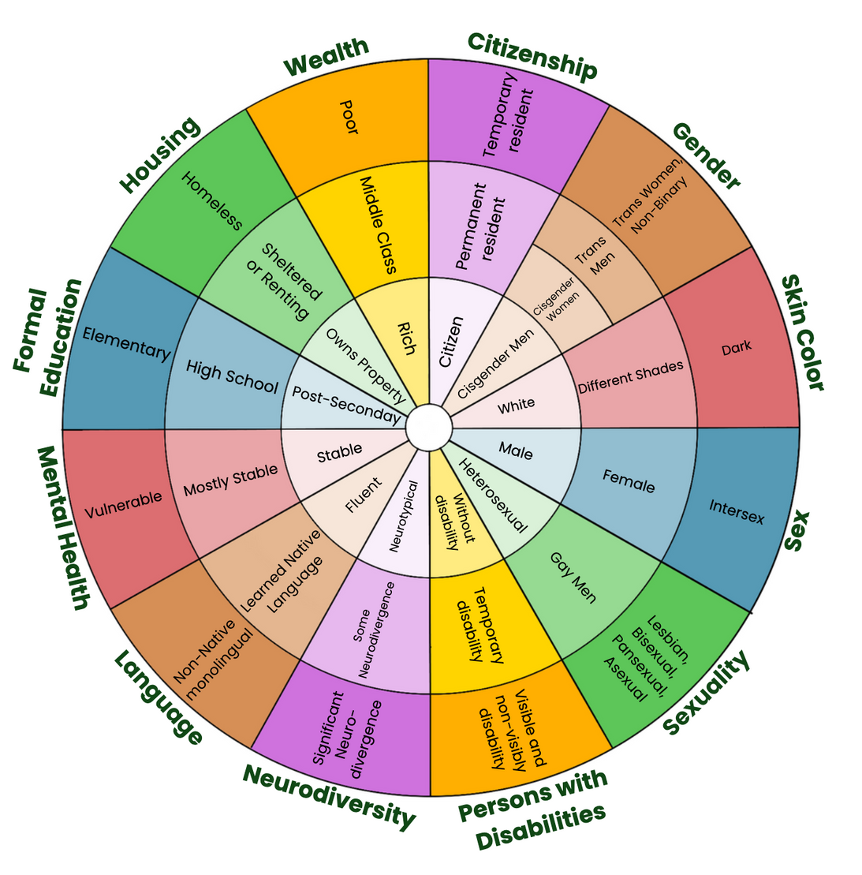
Race
Gender
Wealth
Poistionality
Influences
Bias
Sexuality

Slide 22
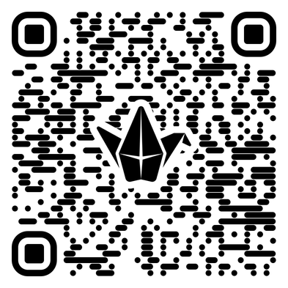


EXPLORING OUR POSITIONALITY AND ITS EFFECTS ON OUR WORK AS TEACHERS
15 mins

Slide 23
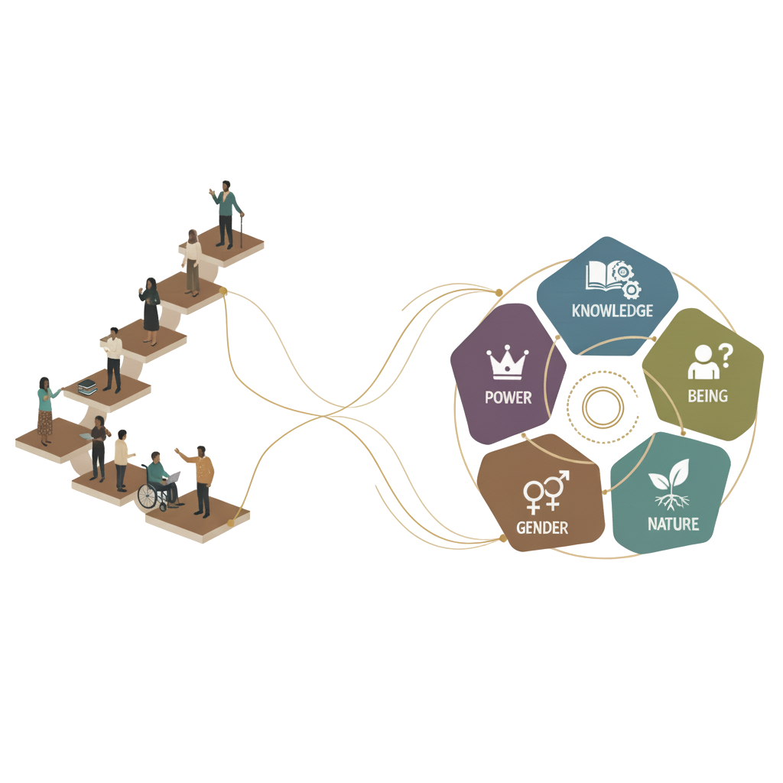


COLLECTIVELY CONNECTING OUR POSITIONALITY AS TEACHERS TO THE COLONIALITY MATRIX
Part 1:
Part 2:
30 mins
30 mins

Slide 24

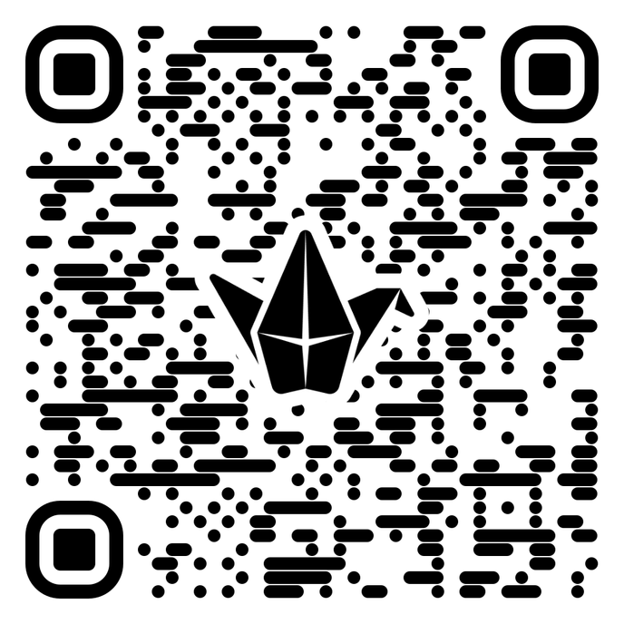
In the Padlet, share how your positionality connects to the coloniality matrix

Slide 25
Take a moment to relax and re-center, we will see you here again in 10 minutes!

Slide 26
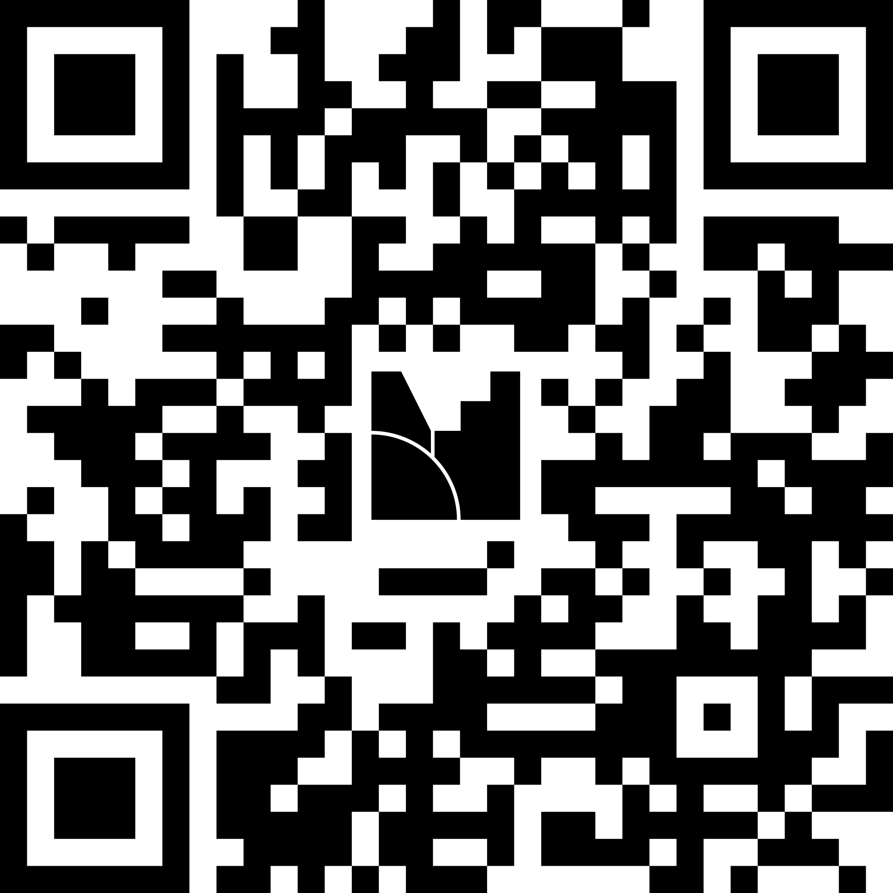
Which coloniality axis was connected most frequently to your statements?
20 mins

Slide 27

Congratulations on making it half way through the trainings!
Take a step back, reflect. Are there any questions?

Slide 28
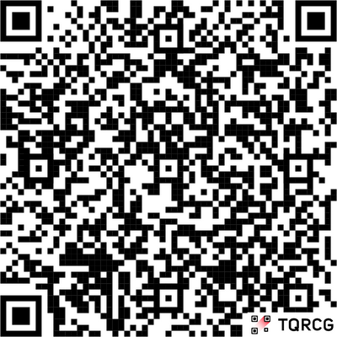
See you in Module 3!
Please don’t forget to fill in the survey!
Funded by the European Union. Views and opinions expressed are however those of the author(s) only and do not necessarily reflect those of the European Union or the European Education and Culture Executive Agency (EACEA). Neither the European Union nor EACEA can be held responsible for them.

Slide 29
References:
Identities & Positionality. (n.d.). Teaching + Learning Lab. https://tll.mit.edu/teaching-resources/inclusive-classroom/identities-positionality/?utm_source=chatgpt.com
Rosen, S. M., Jacobs, C. E., Whitelaw, J., Mallikaarjun, V. R., & Rust, F. (2024). Justice-Centered Reflective Practice in Teacher Education: Pedagogy as a process of imaginative and hopeful invention. Education Sciences, 14(4), 376. https://doi.org/10.3390/educsci14040376
Cunliffe, A. L., Aguiar, A. C., Góes, V., & Carreira, F. (2020). Radical-Reflexivity and transdisciplinarity as paths to developing responsible management education. In SAGE Publications Ltd eBooks (pp. 298–314). https://doi.org/10.4135/9781526477187.n19

